Slide 1
DevOps and Azure
Part 2: Processes
Joshua Davis Azure Customer Engineer joshua.davis@microsoft.com https://github.com/a11smiles/devops-and-azure

Slide 2
Purpose
To understand the definition, roles, and processes within a DevOps culture in order to:
Identify necessary stakeholders
Successfully discover, plan, and migrate supporting infrastructure
Upskill and increase value in knowledge, platforms, and controls for customers
NOTE: The intended purpose is not an exam prep, but the learnings from this series should contribute greatly to your success.

Slide 3
Outline
Azure DevOps/TFS Components Examining and understanding the architecture of a typical TFS infrastructure for proper discovery and planning of a migration.
Processes Understanding various processes for implementing and managing DevOps.
Governance Exploring available controls for governing and protecting code, builds, and deployments.
Automation Transitioning from manually-intensive processes and governance for scale.

Slide 4
DevOps Defined
“An organization that embraces cultural change to affect
how individuals think about work,
value all the different roles that individuals have, accelerate business value, and measure the effects of the change.”
Jennifer Davis Software Engineer, Chef
Ryn Daniels Senior Operations Manager, Etsy

Slide 5
Shift in Mindset
False
Tools
Agile, not Waterfall
Only development teams
All roles “stay in their lanes”
Sovereign gatekeepers
True
Culture
Either can utilize DevOps
All enterprise teams
All roles have a “shared responsibility”
Equal authority (democratization)

Slide 6
Benefits of DevOps
Faster time to market
Higher ROI
Greater user/customer satisfaction
Increased efficiency
Improved collaboration
Early detection and correction of issues

Slide 7
Three Critical Domains
Operations
Development
Security

Slide 8
What DevOps is Not: Waterfall
Discover
Design
Develop
Deploy
Determine
Maintain

Slide 9
What DevOps is Not: Agile
Sprint
1-4 Weeks
Backlog
Sprint Planning
Sprint Backlog
Finished Work

Slide 10
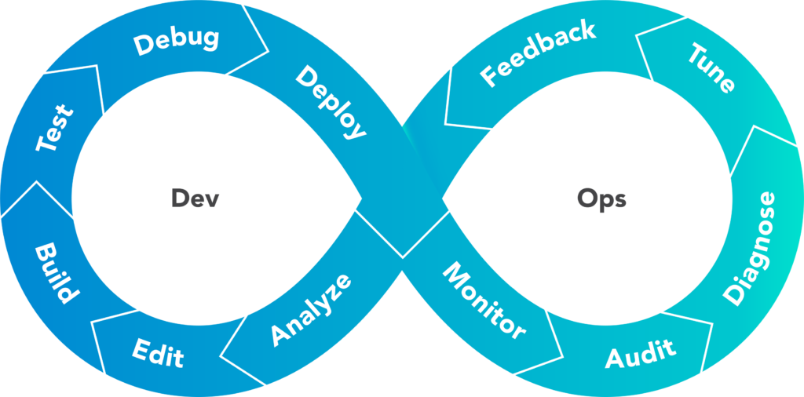
What DevOps is: Whatever it Takes to Increase Value
Dev
Ops

Slide 11
Key Questions
How can the business change the way it works in order to:
Increase efficiency of individual contributors
Increase value of business
Increase effectiveness of change
Bottom Line: How do we best deliver the greatest value?

Slide 12
Case Study
Customer encountered “freezing” applications in Azure App Service
Attempted to leverage App Insights, New Relic, and App Dynamics
None gave them the insights they were looking for
Settled for the latter
Logs were being shipped to Splunk
Failure mitigation involved constantly spinning up “fresh” App Service instances
CET had very little data to work against; logs were generic

Slide 13
Demo: Simple Calculator
Business Requirements
Business wishes to create a “master” online calculator to rule them all.
The first operation will be division, but others will follow.
It should be able to scale to handle anticipated workload.
Maintainability and project management efforts should be minimal.
Functional Specs
Accept two numbers and divide the first (numerator) by the second (denominator) returning the result.
Numbers must be between 0 and 100.

